Slide 1
Why Unsupervised Learning
Unsupervised learning is harder
How do we know if results are meaningful? No answer labels are available.
Let the expert look at the results (external evaluation)
Define an objective function on clustering (internal evaluation)
We nevertheless need it because
Labeling large datasets is very costly (speech recognition)
Sometimes can label only a few examples by hand
May have no idea what/how many classes there are (data mining)
May want to use clustering to gain some insight into the structure of the data before designing a classifier
Clustering as data description

Slide 2
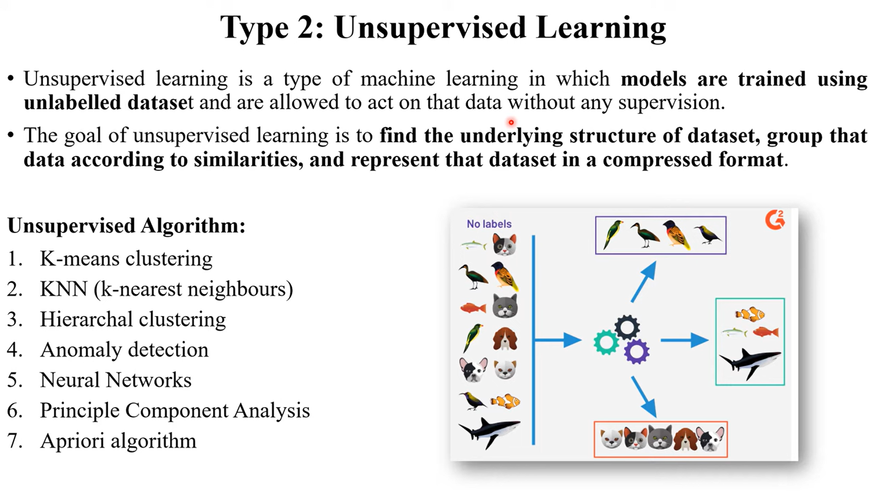

Slide 3
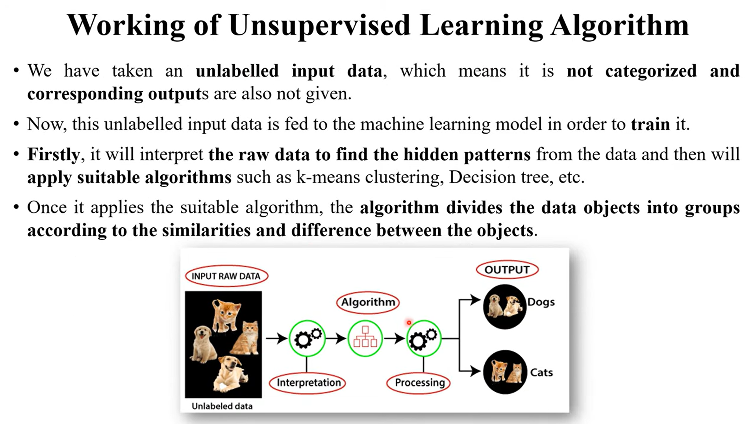

Slide 4
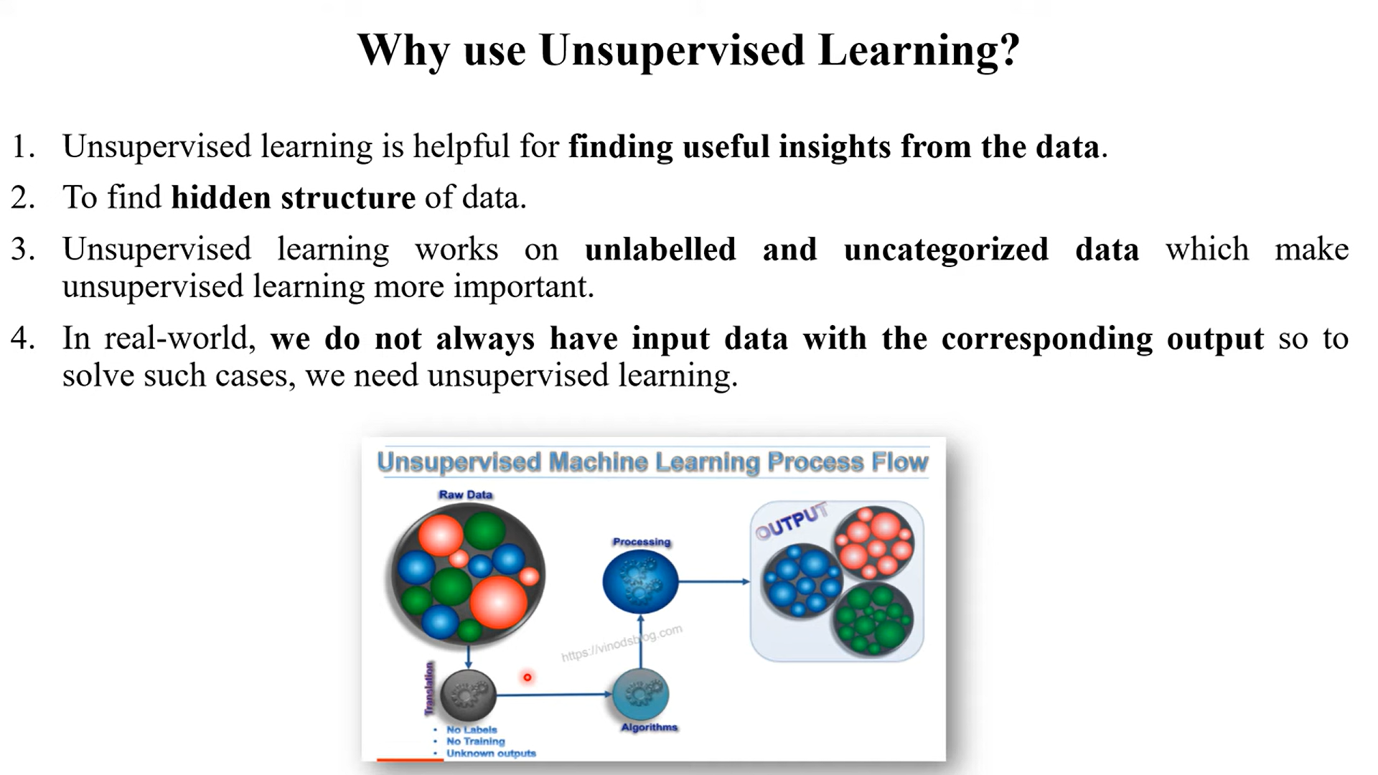

Slide 5
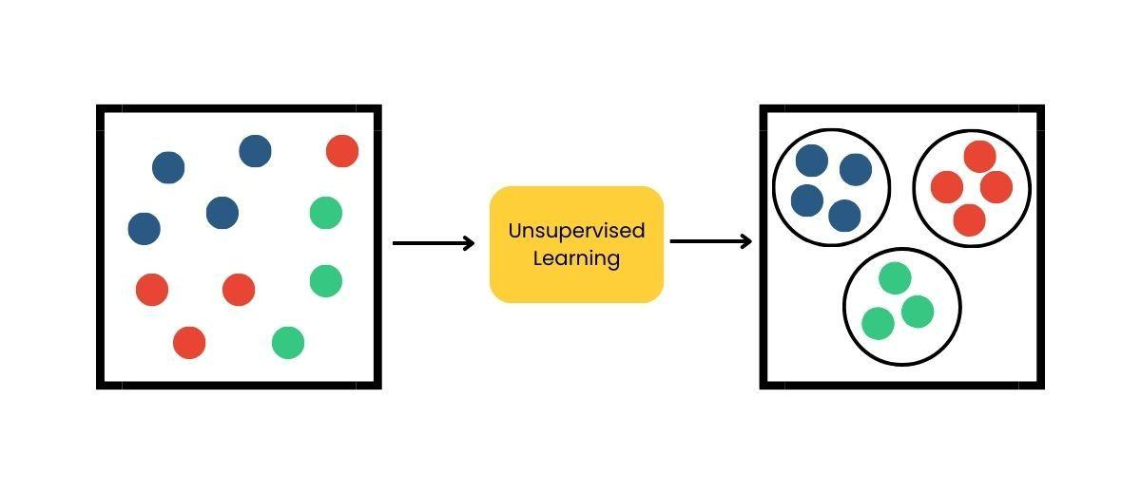
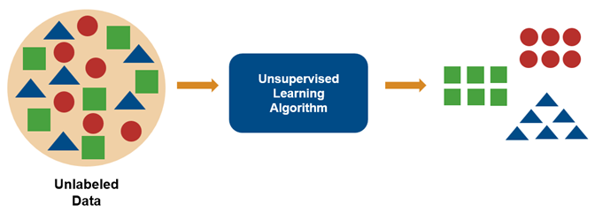
Unsupervised learning

Slide 6
Unsupervised learning
The system tries to learn without a teacher or label.
Some of the most important unsupervised learning algorithms
Clustering
K-Means, DBSCAN, Hierarchical Cluster Analysis (HCA)
Anomaly detection and novelty detection
One-class SVM, Isolation Forest,
Visualization and dimensionality reduction
Principal Component Analysis (PCA), Kernel PCA, Locally Linear Embedding (LLE), t-Distributed Stochastic Neighbor Embedding (t-SNE)
Association rule learning
Apriori, Eclat

Slide 7
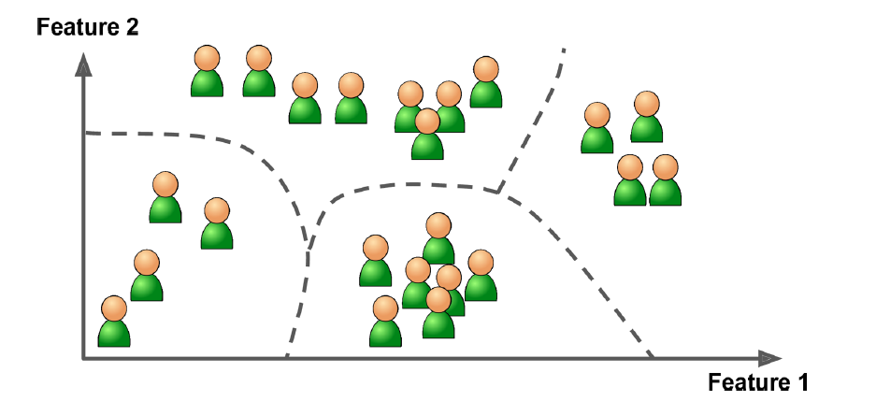
Unsupervised learning - Clustering
The goal is to group similar instances together into clusters. Clustering is a great tool for data analysis, customer segmentation, recommender systems, search engines, image segmentation, semi-supervised learning, dimensionality reduction, and more.

Slide 8
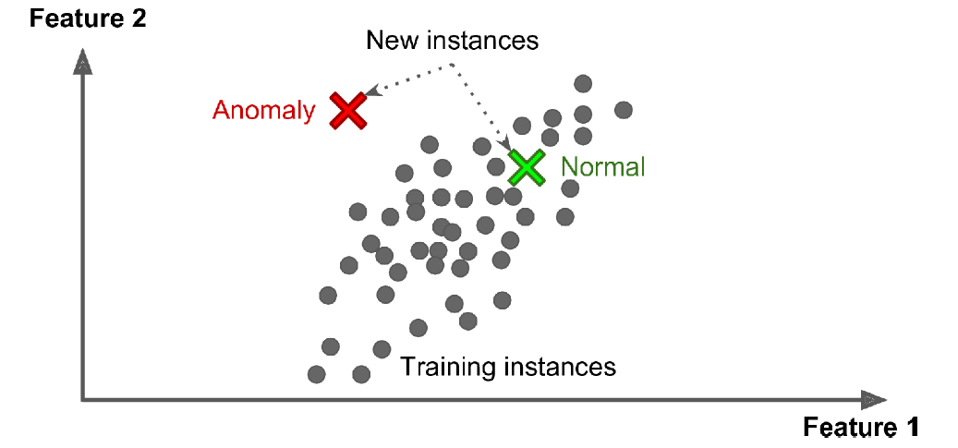
Unsupervised learning - Anomaly detection
The objective is to learn what “normal” data looks like, and then use that to detect abnormal instances, such as defective items on a production line or a new trend in a time series.

Slide 9
Unsupervised learning - Anomaly detection
Density estimation
This is the task of estimating the probability density function (PDF) of the random process that generated the dataset.
Density estimation is commonly used for anomaly detection: instances located in very low-density regions are likely to be anomalies.
It is also useful for data analysis and visualization.

Slide 10
The basic steps that an expert must follow in order to develop a clustering task are the following:
Feature selection: Features must be properly selected so as to encode as much information as possible concerning the task of interest.
Proximity measure: This measure quantifies how“similar”or“dissimilar”two feature vectors are. All selected features contribute equally to the computation of the proximity measure and there are no features that dominate others.
Clustering criterion. This criterion depends on the interpretation the expert gives to the term sensible, based on the type of clusters that are expected to underlie the data set.
Clustering algorithms: Having adopted a proximity measure and a clustering criterion, this step refers to the choice of a specific algorithmic scheme that unravels the clustering structure of the data set.

Slide 11
The basic steps that an expert must follow in order to develop a clustering task are the following:
Validation of the results: Once the results of the clustering algorithm have been obtained, we have to verify their correctness. This is usually carried out using appropriate tests.
Interpretation of the results: In many cases, the expert in the application field must integrate the results of clustering with other experimental evidence and analysis in order to draw the right conclusions.

